Slide 1
Student Performance Analysis Habiba Abdullah said Hammad-2203167

Slide 2
AGENDA
Problem statement
Dataset Snapshot
Key distributions
Student Clusters
Predictive Models
Key Insights and Action
Recommendations and final steps

Slide 3
Problem Statement
Problem: Schools often miss early signals of student risk.
Goal: Use data-driven models to predict and support at-risk students.

Slide 4
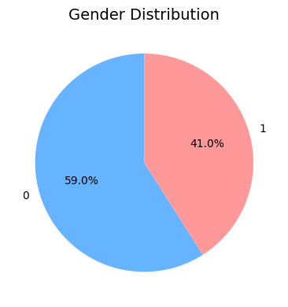
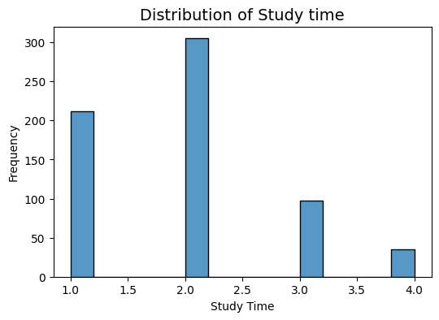
Dataset in a snapshot
649 students (2 Portuguese schools)
33 attributes → demographics, behavior, academic records
Target: risk group & final grade

Slide 5
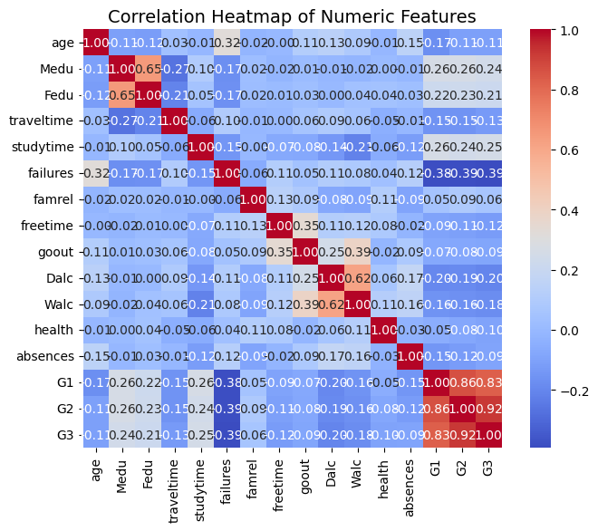
Correlation Between features
Key Findings:
Prior grades (G1, G2) strongly predict final grade → potential data leakage.
Failures negatively associated with performance.
Absences alone show weak correlation, but when combined with social/study factors, risk increases.
Study time shows only weak positive effect.

Slide 6
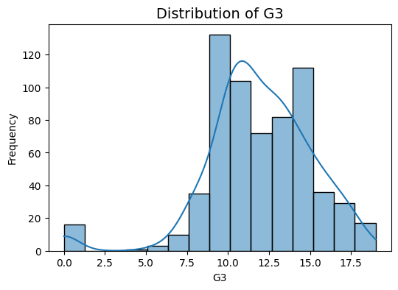
Final Grade Distribution
Key Findings:
Most students cluster around mid-range scores (10–14).
Fewer students achieve very high scores (18–20), showing top performance is rare.
A noticeable share of students fall below passing threshold (<10), highlighting the at-risk group.
Distribution suggests strong middle performance with clear tails of both low and high achievers
.

Slide 7
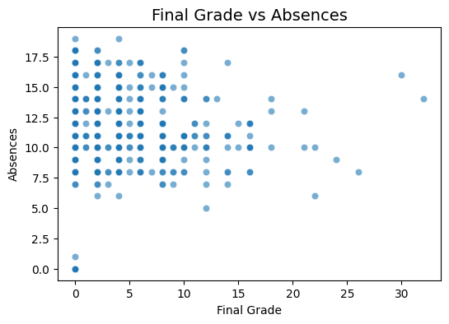
Impact of Absences on Performance
.
Key Findings:
Students with higher absences generally show lower final grades.
Relationship is not perfectly linear, but extreme absences clearly harm performance.
Confirms absenteeism is an early warning signal for academic risk.
Reinforces the need for an attendance monitoring system as a first intervention.

Slide 8
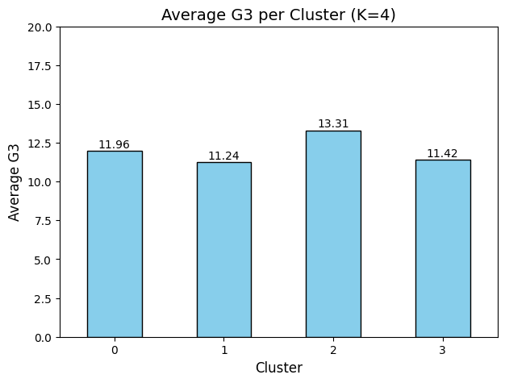
Clustering Results
Cluster 0: High performers (“Diligent”)
Cluster 1: Moderate but disengaged (“Quiet Achievers”)
Cluster 2: Average students
Cluster 3: High absence/low performance (“Skippers”)
Clustering helps identify early intervention groups.

Slide 9
Predictive Models
)
Model | Dataset | Accuracy | F1-Score
Logistic Regression | With Prior Grades | 93% | 0.89
Random Forest | With Prior Grades | 92% | 0.89
Decision Tree | With Prior Grades | 92% | 0.90
Logistic Regression | Without Prior Grades | 60% | 0.44
Random Forest | Without Prior Grades | 66% | 0.55
Decision Tree | Without Prior Grades | 55% | 0.42
Target: Predict 3-class risk group (Low, Medium, High Risk).
Algorithms Tested: Logistic Regression, Decision Tree, Random Forest.
Two Settings:
With prior grades (G1, G2) → very high accuracy (>92%) but risk of data leakage.
Without prior grades → moderate accuracy (55–66%) but more realistic predictors.
Evaluation Approach:
Train/Test split (80/20).
Cross-validation for reliability.
Hyperparameter tuning via Grid Search.
Key Insight: Prior grades dominate prediction, but models without them highlight meaningful behavioral & demographic

Slide 10
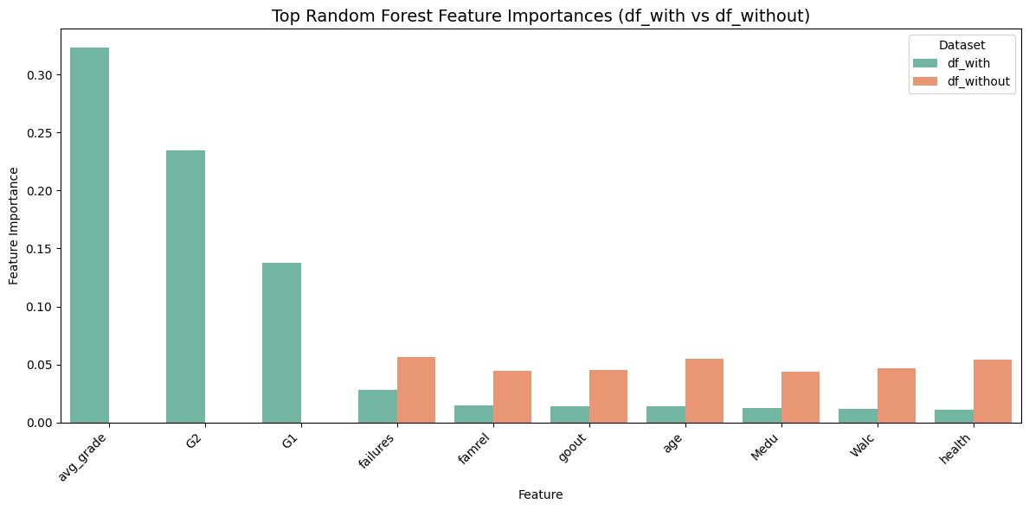
Important features
Key Findings:
Prior failures & absences consistently predict risk.
Parental education shows notable influence.
Prior grades dominate prediction in df_with (confirming data leakage).
Random Forest achieved the highest overall performance.

Slide 11
Key insights and actions
Absences are the strongest early warning signal
Quiet Achievers risk plateauing
Parental education strongly influences outcomes
Past failures create long-term academic struggles
Cluster-based early warning system boosts prediction to 92%
Deploy an automated attendance monitoring system with supportive outreach.
Launch tailored engagement workshops & structured mentorship.
Strengthen family engagement through practical workshops & support.
Implement an “Academic Fresh Start” recovery program with counseling & resilience training.
Use automated risk classification for timely, personalized interventions.

Slide 12
Next steps
Pilot & Scale: Test the attendance monitoring system and cluster-based early warning tool in a small cohort before rolling out school-wide.
Evaluate Impact: Collect feedback from students, families, and teachers to measure effectiveness of interventions.
Refine Models: Continue improving accuracy while auditing regularly for bias and fairness.
Expand Data Collection: Incorporate additional behavioral and socio-emotional indicators for a more holistic risk profile.

